Slide 1
DX University
Visalia California – 2014

Slide 2
Station & Antenna Considerations
Ned Sterns AA7A

Slide 3
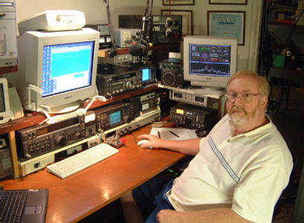
Ned Stearns AA7A
First licensed in 1963 at age 12, he has been a serious Dxer since 1974.
Top of the Honor Roll, 5BWAZ, Satellite DXCC, and the first ever 11-band DXCC (160 through 2 meters, inclusive).
Dxpeditions in 1979 as AA7A/VP2A ; 1999 as 3B9R ; 2000 as K5K.
Member of the VooDoo Contest Group since 2005. Currently the team co-leader and station designer.
Serves as a director on the NCDXF.

Slide 4
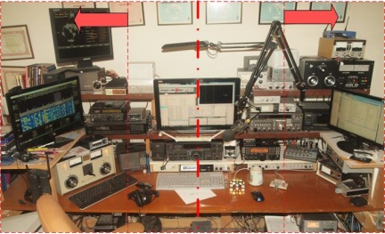
Topics
Radios
Antennas
Other Station Elements
Station Layout

Slide 5
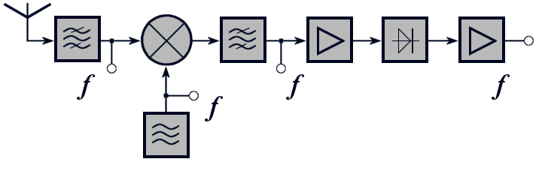
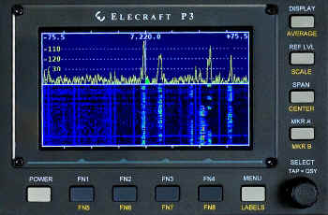
Radio Equipment - Receivers
Critical receiver requirement
Selectivity
Dynamic range
Split frequency operation
Advanced capability
Second receiver or sub-receiver
Diversity reception
Panadapter displays
Software Defined Radios (SDR)

Slide 6
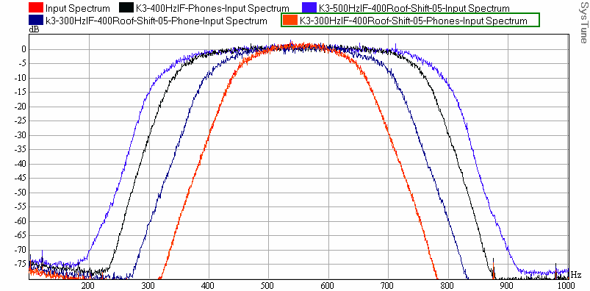
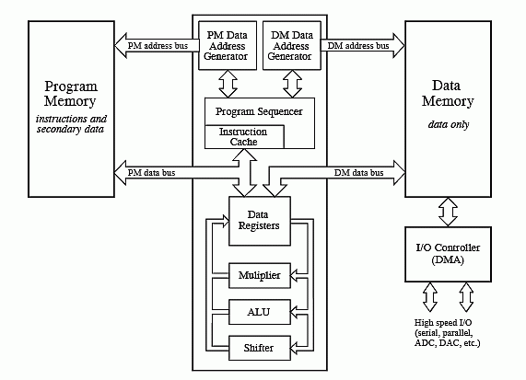
Receiver Selectivity
Roofing Filters
Limits power applied to non-linear receiver elements
Digital Signal Processing
Bandpass filters
Notch filters
Noise Reduction algorithms
Noise Blanking

Slide 7
Receiver Dynamic Range
One simple definition: Blocking Dynamic Range
Copy a weak signal simultaneously with a high level, off-channel signal
Ratio of signal amplitudes at point when degradation of weak signal starts
Radio | BDR, dB
Elecraft K3 | 139
Ten Tec Orion II | 136
Yaesu FTdx9000D | 127
ICOM IC-7800 | 115
ICOM IC-756PROIII | 101

Slide 8
Transmitter - Critical Requirements
Power level
Heat is at the root of most component failures
Consider operating radios well below maximum power levels
Modulation Quality – How good (or wide) is your signal?
Undesirable sidebands – clicks or ɸ noise will get you noticed
Reduce audio distortion – audio processing may result in higher average power but can result in lower understandability
Consider covering all the operating modes
Traditional modes (CW, SSB, AM, RTTY) are native
New modes (e.g. PSK, JT65) may require external modems

Slide 9
Antennas
Requirements related to effective DXing
Pattern matching propagation path to DX
Pattern reducing effects of interference
Efficiency
General characteristics
Efficient antennas are likely to be narrowband
Antennas are the best investment in your station
Reliability can be more important than performance
Higher antennas work DX better than lower ones

Slide 10
Low frequencies antennas (160 & 80 m)
Transmit antennas
Verticals
Dipoles (as high as possible)

Slide 11
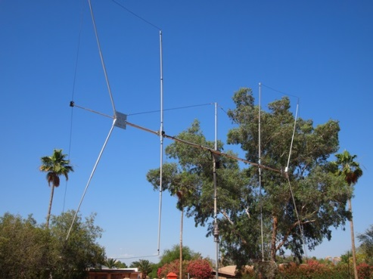
Low frequencies antennas (160 & 80 m)
Receive antennas
Beverages
Loops
(ground-dependent antennas)
Flag/pennants
(ground-independent antennas)
4-square short verticals

Slide 12
Antennas - HF
Monoband antennas
Full size: Yagi¹
Shortened: Moxon²
1
2

Slide 13
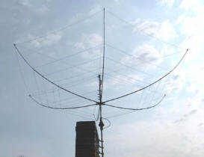
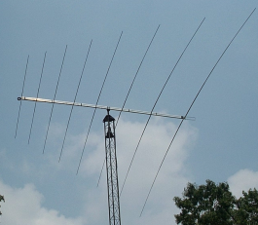
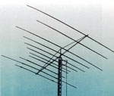
Antennas - HF
Multi-band antennas (Fixed)
Hexbeam¹
Spider beam²
Log periodic³
Quad⁴
Multiband Yagi⁵
1
2
3
4
5

Slide 14
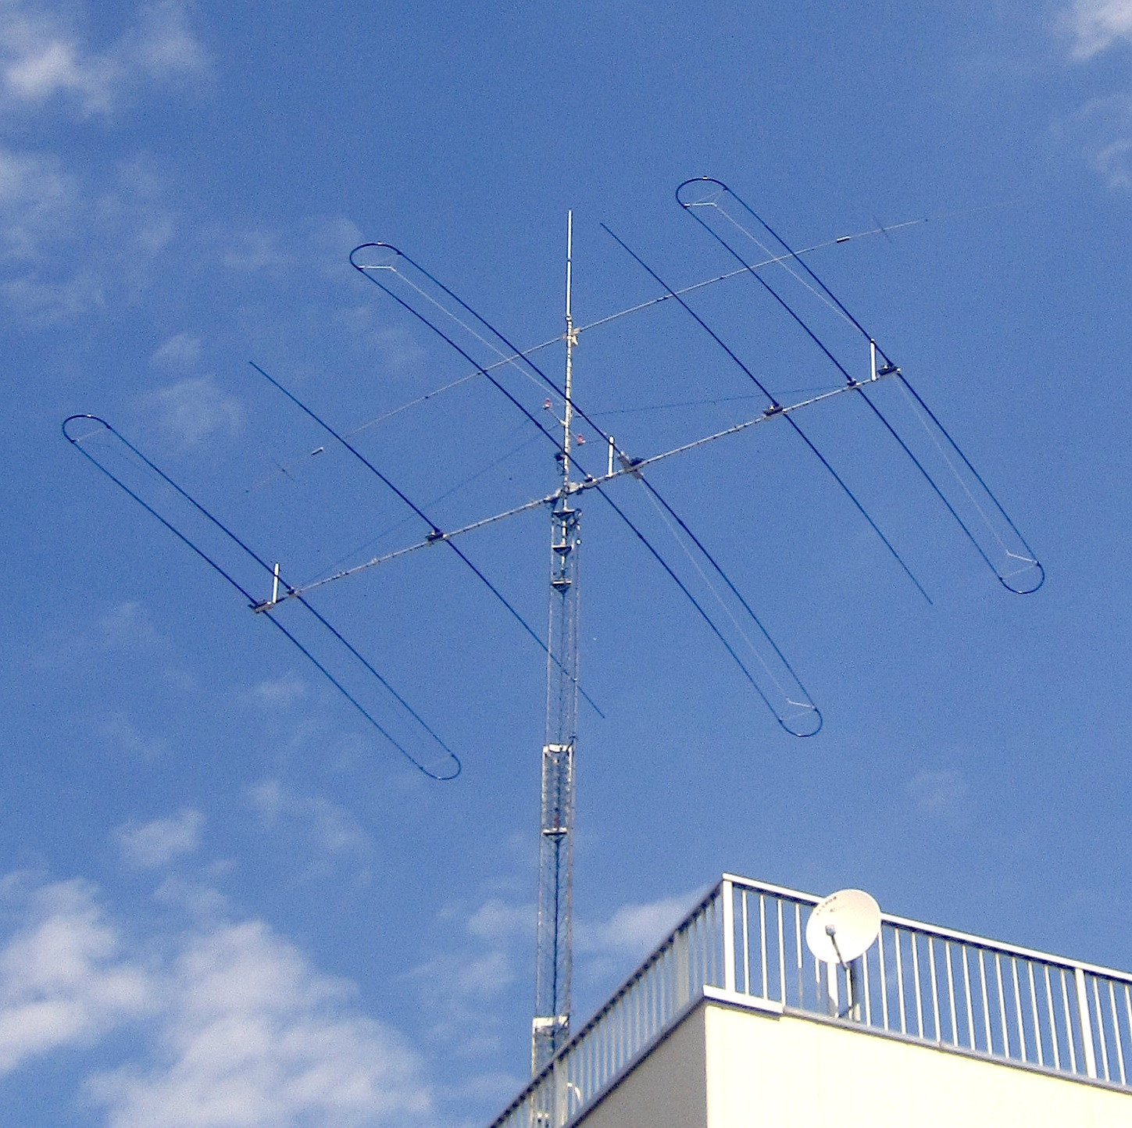
Antennas - HF
Adjustable
SteppIR

Slide 15
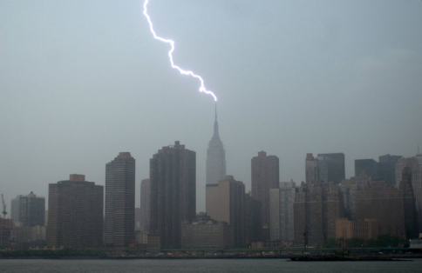
Other Station Elements
Grounding
Nearby lightning strike protection
Shock hazard mitigation
Audio ground loop reduction

Slide 16
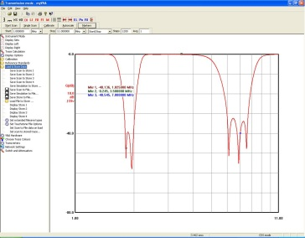
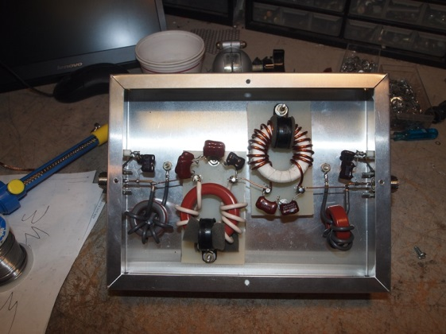
Other Station Elements
Filtering
Harmonic suppression
BCI reduction
Protection of local equipment

Slide 17
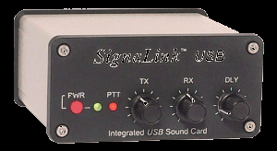
Other Station Elements
Audio Transducers
Headphones / speakers
Microphones
PC CODECs

Slide 18
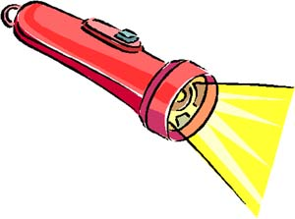
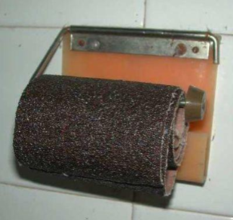
Station Layout Considerations
Reduce stress and strain
Organization of equipment
Neck strain reduction
Minimize eye strain
Lighting
Must see the radio knobs
Must see keyboards
Ambient sound
Fan noise
Clunking relays
Posterior comfort

Slide 19
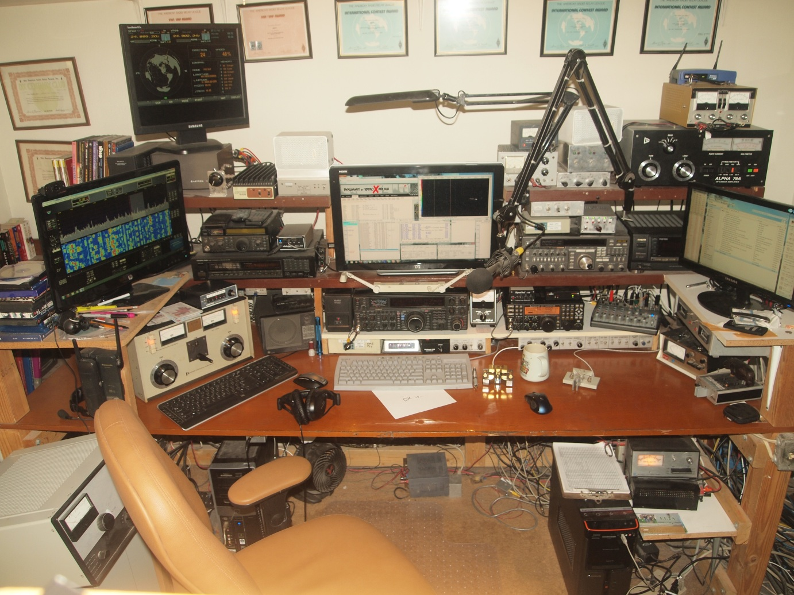
AA7A Station – 10 Feb 2012 (at 1646 Z )
Rotor Display
HF Radio #1
HF SDR #3
HF Amplifier #2
SDR Display
HF Radio #2
HF Logging Computer mon #2
HF Logging Computer mon #1
HF Amplifier #1
12-channel Audio Mixer
HF Wattmeter
HF Amplifier #3

Slide 20
AA7A Station – Operator Focus
Secondary Focus
Primary Focus
Secondary Focus

Slide 21
Station & Antenna Considerations
Happy Hunting!
Notes:
LAST SLIDE IN PRESENTATION

